Slide 1
CARe: Communication, Apology and Resolution
Approaching adverse events with empathy
[Name,
Credentials,
Date]
Notes:
This presentation is a resource for someone at a facility looking to introduce/convince the topic to a group of clinicians.

Slide 2
Objectives
Describe:
Benefits of the CARe program for patients, clinicians, and health care systems, in comparison to a traditional liability model
Essential elements of a successful CARe program
Key CARe action steps to take immediately following an adverse event

Slide 3
Introduction and background

Slide 4
Adverse event
DEFINITION
“An injury that was caused by medical management rather than the patient’s underlying condition.”
Adverse events can result from errors, but not necessarily
(i.e., a bad outcome from a procedure, adverse patient reaction to medication)

Slide 5
Why do patients sue?
“Studies show that the most important factor in people’s decisions to file lawsuits is not negligence, but ineffective communication between patients and providers.”
“Malpractice suits often result when an unexpected adverse outcome is met with a lack of empathy from physicians and a perceived or actual withholding of essential information.”
Clinton & Obama, NEJM 2006
Vincent C, Lancet 1993
Notes:
One of our greatest fears as clinicians is being involved in adverse events because we believe that these can lead to lawsuits. Several studies were conducted to find out why people sue, and it was found that it is actually the reluctance to talk with patients about the events and the lack of empathy surrounding them is what most frequently causes lawsuits, and not the actual event or error itself.
100% of clinicians make mistakes
OPTIONAL: TED excerpt
https://www.ted.com/talks/brian_goldman_doctors_make_mistakes_can_we_talk_about_that?language=en

Slide 6
Traditional approaches to mistakes
Pretend they never happened, don’t talk about them.
“Deny and Defend,” anything that is already known, and hope patients never show up in court
Notes:
The traditional risk management model fits in a system dominated by the tort process, where in order to survive in court providers and hospitals had to take a deny and defend approach. Refusing to talk about a case, refusing to acknowledge the patient’s or provider’s needs, hoping a case just goes away. It has largely been a reactive process. Reactive to lawsuits but not using the opportunity to learn from a case or resolve things in a just and fair way.

Slide 7
What is wrong with the status quo?
  Damaging to patient/provider relationship
  Inefficient and expensive
  Impedes patient safety improvement
Patients
Providers
  Damaging to future patients
  Negative health impacts
  Costly
Health Care System
  Drive up overall cost of healthcare
  Compromises access to care
  Thwarts patient safety improvement
  Drives over-utilization
Gallagher Arch Int Med 2006; Boothman, Front. Health Svcs Mgmt 2012.
Notes:
Prolonged process of resolution with multiple victims
Lost opportunity to learn from the mistake on an individual and institutional level

Slide 8
What is CARe?
CARe stands for Communication, Apology and Resolution and means:
  Communicate with patients and families when unanticipated adverse outcomes occur
  Investigate and explain what happened
  Implement systems to avoid recurrences of incidents and improve patient safety
  Where appropriate, apologize and offer fair financial compensation without the patient having to file a lawsuit

Slide 9
Principles of CARe
Compensate patients quickly and fairly when unreasonable medical care caused injury.
If the care was reasonable or did not adversely affect the clinical outcome, support caregivers and the organization vigorously.
Reduce patient injuries (and therefore claims) by learning through patients‘ experiences.
Source: “Nurturing a Culture of Patient Safety and Achieving Lower Malpractice Risk Through Disclosure: Lessons Learned and Future Directions.” Boothman, et al; Frontiers of Health Service Management 28:3; study at the University of Michigan Health System.

Slide 10












Advisory board

Slide 11
Communication, Apology and Resolution
THE BASICS
Communicate
Proactively communicate with patients/families about adverse events
Apologize
Offer empathy and, where appropriate, an apology of responsibility
Investigate
Investigate the events to find root causes and develop corrective actions to improve patient safety
Move toward healing
Have resolution conversations to discuss those findings with the patients/families
Resolve
Resolve cases with compensation outside of the court system (patients who may receive compensation are encouraged to have attorneys.)
Ensure patient safety improvements are made
Connect them with team members who can help them throughout CARe
Proactively move the case to the insurer for resolution if criteria are met

Slide 12
Why use CARe?
Better for patients
Treated with compassion and honesty
Can get the answers and support they need
Fairer and more timely process than court system
Better for providers
Preserves provider/patient relationship when possible
Can express natural empathy and get support they need
True systemic root causes are more likely to be unearthed
Better for the healthcare system
Less defensive medicine
System improvements are made
Builds trust in the system which can increase reporting and morale

Slide 13
CARe data

Slide 14
What does the data show?*
Claims/costs do not increase even when systematically using the program, and in many cases decrease
Providers are supportive of the use of the program
Patients are supportive of the use of the program
Patients who do not receive the components of the program suffer long-term negative impacts
Systematic, rigorous application of the program is needed to receive the full benefits of the program, including improved safety culture
*See appendix for complete publication list.

Slide 15
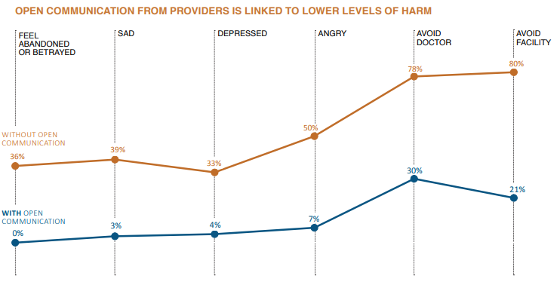
Open communication from providers is linked to lower levels of harm
Learn more at BetsyLehmanCenterMA.gov/CostOfMedicalError
Notes:
Source: Cost of Medical Error Report

Slide 16
Areas of investigation
MASSACHUSETTS
Data collected | Outcomes
Institution-level data on volume and costs of claims and lawsuits Case-specific data for each adverse event that meets study criteria Survey of providers involved in a CARe case Interviews with key personnel Monthly pilot site check-in calls | Institutional liability outcomes Case level outcomes Provider satisfaction with CARe CARe implementation experiences
Notes:
We have collected a variety of data on the CARe program which we will use to investigate three main topics. [Next slide.]

Slide 17
The Massachusetts pilot sites
Site | #Beds | Location | Teaching (Y/N)
Beth Israel Deaconess Medical Center | 642 | Urban | Y
BID-Milton | 88 | Community | N
BID-Needham | 58 | Community | N
Baystate Medical Center | 716 | Urban | Y
Baystate Franklin Medical Center | 93 | Community | N
Baystate Mary Lane Hospital | 31 | Community | N

Slide 18
Cases tracked in MA study
Screened in:
991
Referred to insurer:
160 (16%)
99 closed (61.9%)
Not referred to insurer:
821 (83%)
817 closed
(99.5%)
Insurer status not yet determined:
10 (1%)
All pending

Slide 19
Conclusions
CARe does not lead to an avalanche of new claims or require many cases to be sent to insurer
Resolved cases were settled with median payment of $75K (compensation in < 5% of CARe cases); only 9% resulted in compensation
Most of the work of CARe is communicating about non-error events
Notes:
Very few (9%) lead to compensation.
Compensation costs overall were modest (median $75K)
Overall conclusion: the program is good for patients, good for providers, good for patient safety – in short, it’s the right thing to do, and it can be done without increasing

Slide 20
Results: Were there any statistically significant changes (p<0.05) in liability trends?
Outcome | CARe CRP Hospitals | Comparison Hospitals (No CRP)
New claims | Lower at community hospitals and 1 academic medical center | No change
Defense costs | Lower at both academic medical centers | No change
New claims receiving compensation | No change | No change
Compensation costs | No change | No change
Average payment per claim | No change | No change
Time to resolution | No change | No change

Slide 21
Conclusions
Large cost savings reported by some early adopters did not occur, but there were no cost increases
Hospitals can “do the right thing” without increasing their liability exposure
CRP discussion should move away from liability concerns to how best to implement programs and leverage patient safety improvements
Notes:
Very few (9%) lead to compensation.
Compensation costs overall were modest (median $75K)
Overall conclusion: the program is good for patients, good for providers, good for patient safety – in short, it’s the right thing to do, and it can be done without increasing

Slide 22
What patient safety improvement ideas has CARe generated?
Patient Safety Improvement | n
Investigation findings shared with involved staff | 36
Educational efforts | 34
Policy changes | 21
Safety alerts sent to staff | 14
Input into internal QI system for ongoing analysis | 10
New process flow diagrams created and disseminated/posted | 10
Human factor engineering analysis | 6
Other | 10
*n=114 CARe insurer cases
Notes:
For all CARe insurer cases (n=160), we ask, “What patient safety improvements, if any, have been or are likely to be implemented by the hospital because of this incident (and others like it)?” We provide a list of possible improvements and ask RMs to “check all that apply”. (That’s why sum > the number of CARe insurer cases we have.)
In a third of CARe insurer cases (54/160), one or more patient safety improvements were identified. Most commonly, involved staff were informed of investigation findings and educational efforts were implemented. We also saw a fair number of policy changes resulting from CARe insurer cases.
Anecdotal evidence from check-in calls with pilot sites and interviews with leadership indicates that there are more patient safety improvements than what gets captured by our form in REDCap since hospitals also learn a lot from cases that do not get referred for CARe Insurer Resolution.

Slide 23
Providers are supportive of CARe overall
# of respondents
Extremely unsupportive
Score
Extremely supportive
*74 respondents said they did not know enough to answer this question.
Notes:
Answering on a scale from 1 to 10--where 1 indicates that they are “extremely unsupportive” of using CARe and 10 indicates they are “extremely supportive” of the program--over 80% gave it a rating of 8 or higher. The majority of those who felt they could answer this question (58/108=54%) gave it a “10”.

Slide 24
After an adverse event

Slide 25
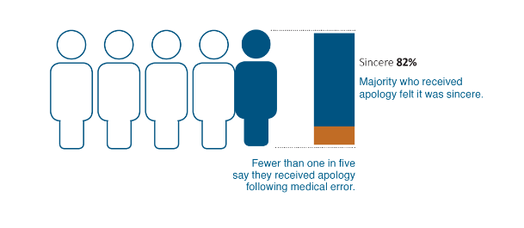
After a medical error
Patients and families rarely receive an apology or offer of support following a medical error

Slide 26
After a medical error
Open communication from providers is linked to lower levels of harm
Data and graphic from the Betsy Lehman Center Cost of Medical Error Report – 2019- https://betsylehmancenterma.gov/research/costofme

Slide 27
Factors facilitating successful implementation
Deep engagement by high-level physician champions
Strong buy-in from risk management
Practical support and oversight by project managers
No barriers erected by insurer
Pre-existing just culture commitment
Sense of community and support from MACRMI

Slide 28
CARe algorithms and procedures

Slide 29
CARe adverse event pathway
CARe Event occurs
Standard of Care NOT met and caused significant harm
CARe Insurer Pathway: In coordination with insurer: explain what happened, formally apologize, proactively offer compensation
Standard of care met or low-level harm
Explain what happened and answer patient questions; continue to express empathy; option of good will gesture
Respond immediately to the patient’s clinical needs, communicate proactively, express empathy, investigate, make changes to improve patient safety and inform patient of those changes
16%
84%

Slide 30
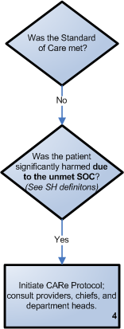
Defining a “CARe case”
THE FILTER
If an internal investigation team determines that:
  The standard of care was not met, AND
  The unmet standard of care caused significant harm
  … the case is a CARe Insurer Case, and will follow the insurer protocol.
/unsure

Slide 31
CARe insurer case protocol
If selected by the “filter,” case is referred to insurer as CARe case
Case reviewed by insurer and external experts
CARe cases will proceed with a meeting with insurer, patient, patient’s attorney, and providers (if applicable) to formally apologize, discuss the case, and offer compensation

Slide 32
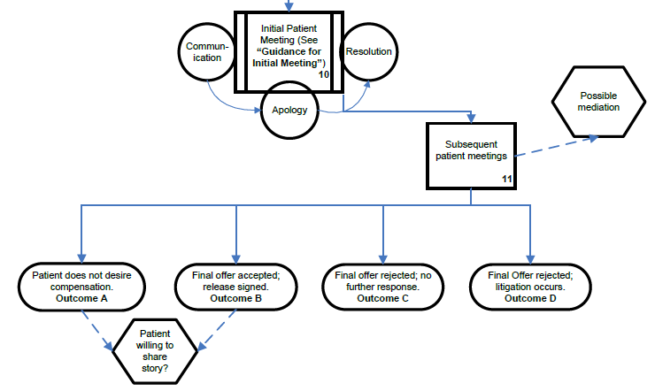
CARe insurance case protocol
POTENTIAL OUTCOMES

Slide 33
24-48 hours
Patient Safety Alerted
Support services for providers and patients launched
Discussion with patient regarding error and known facts
(1,2)
2-4 weeks
Internal investigation takes place
Patient Safety and Patient Relations maintain contact with providers and patients respectively
(3)
2-5 months
Insurer reviews case and develops offer parameters
Provider/System Allocation by insurer
Insurer invites patient to CARe Initial Meeting; recommends that counsel also attend
Lessons learned implemented at site
(6,7,8,9)
1-3 months
Determination of CARe criteria fit
Providers, Chiefs, and Directors consulted
Team huddle; designee conducts Initial CARe Communication with the patient; connects them to Insurer for record release
(4,5)
3-6+ months
Initial meeting with insurers, providers, patient safety staff, patient, counsel, and other parties.
Additional meetings occur as necessary.
Final offer to patient made and accepted or rejected.
(10,11)
Communication, Apology and Resolution
TIMELINE

Slide 34
Steps following an adverse event:
Educating clinicians
Step 1: Report the event and get help with communication (Pager system/Reporting System/Call)
Step 2: Communicate with the patient/family about the event; be empathetic and use statements of regret (“I am so sorry this happened to you…”); discuss facts known at this time and do not speculate or blame others.
A note on Apology:
  1. Statements of Regret – Always!
  2. Apology of Fault – Once facts are known (if applicable)
Step 3: Document the communication with the patient/family in the record; facts, who was present, and results of conversation.
Step 4: Check back in with the patient/family and discuss with them the findings and any systemic improvements to be made once all facts are known and root causes have been determined.

Slide 35
Case samples

Slide 36
Adverse event
SAMPLE CASE
Mr. Negashe calls the hospital patient relations office to voice a complaint that his doctor never provided information about blood work drawn during a clinic visit, and that in the meantime he had to be admitted to the hospital.
He went to the emergency room when he developed blurry vision and was admitted to the ICU where he learned that he had diabetes. He is worried that his vision problems are permanent. He is now insulin dependent and thinks that may not have been the case if detected earlier. He works as a driver and has been unable to work for several weeks.
He is calling to simply to voice his dissatisfaction and alert the hospital to the problem. He does not indicate an expectation.
Notes:
Use an example from your own institution if relevant.

Slide 37
Adverse event
SAMPLE CASE, CONTINUED
Patient relations reviews the case and learns that the patient had an elevated HgbA1C several months earlier, and follow-up was encouraged.
When he did return, he was seen by the physician, who drew a repeat test but did not follow-up with the patient. The patient called the clinic twice for results and these calls were forwarded to the physician, but no return call was made. The clinic did not have a “closed loop” system to identify whether calls had been returned.
The HgbA1c was markedly elevated on repeat test.
Peer review confirms that immediate follow-up was indicated in this situation, as the patient was at significant risk of becoming acutely ill.
Notes:
Use an example from your own institution if relevant.

Slide 38
Adverse event sample case
RESOLUTION
Mr. N. received an explanation, an apology and compensation
  Compensation based on expenses encountered, lost work, pain and suffering
Payment was determined and made by hospital’s insurer on behalf of the hospital and physician
With physician’s endorsement, responsibility was apportioned 50/50
Case was shared in multiple institutional forums to prevent recurrence

Slide 39
Adverse event
SAMPLE CASE
Mrs. Alcott called her PCP’s office in September about a CT scan she had in March prior to undergoing an emergent cholecystectomy. She said she heard from a specialist that there were some “worrisome findings” on it that should have been followed up on.
The nurse at the PCP’s office read her the report, which noted that a pelvic ultrasound was recommended for further evaluation of an adnexal enlargement. Mrs. Alcott was extremely upset because she had just been diagnosed with ovarian cancer, and asked that a surgeon call her back to explain to her why this was never followed up on.
An attending surgeon who was involved in her follow up care from the hospital attempted to contact the patient, but the call was not returned.
A pre-litigation notice was filed on behalf of the patient by her attorney shortly after.
Notes:
Could present this case as an alternative to Mr. Nagashe’s case.

Slide 40
Adverse event
SAMPLE CASE, CONTINUED
The hospital’s quality staff arranged a meeting between Mrs. Alcott and her attorney, the Surgery QI Director, and an attorney from the Insurer to discuss what happened, apologize for the error that was made, explain how it will be prevented in the future, and to work with the patient compensate the patient for the potential loss she experienced in this delay of diagnosis.
The patient and the providers involved in the meeting felt that this meeting to explain, apologize, and discuss the corrective actions was extremely helpful in the healing process for everyone.
4 months later, the parties had reached an agreement and the case was resolved.
Notes:
Could present this case as an alternative to Mr. Nagashe’s case.

Slide 41
Publications
Data addressing success factors for CARe Programs, published January 2020:
https://qualitysafety.bmj.com/content/early/2020/01/20/bmjqs-2019-010296.long
Data addressing costs, claim numbers, and time to resolution, published November 2018:
https://www.healthaffairs.org/doi/full/10.1377/hlthaff.2018.0720?url_ver=Z39.88-2003&rfr_id=ori%3Arid%3Acrossr ef.org&rfr_dat=cr_pub%3Dpubmed
Data addressing claims numbers, provider satisfaction, and adherence published in Health Affairs in 2017:
http://www.healthaffairs.org/doi/10.1377/hlthaff.2017.0320
Data regarding patients and medical error in Massachusetts, including patient responses with early communication, and without:
https://www.betsylehmancenterma.gov/research/costofme

Slide 42
Thank you!
Contact Information:
Melinda Van Niel
Melinda.VanNiel@betsylehmancenterma.gov

