Slide 1
STAY SAFE AT WORK DURING COVID-19
Remember these tips to protect yourself, the people you are caring for, and your community from coronavirus and other germs.
©2020 Betsy Lehman Center for Patient Safety ● BetsyLehmanCenterMA.gov/HomeCare

Slide 2


Practice good hygiene at work and at home
Wash your hands often. Use soap and water or hand sanitizer. Always clean hands for at least 20 seconds.
Use disinfectant to clean things that others will touch too. Door handles and counters are examples.
Don’t share food with others. Limit the number of people in the break room at work. Eat outside when possible.
Don’t get too close to other people. Keep at least 6 feet away whenever you can.
©2020 Betsy Lehman Center for Patient Safety

Slide 3
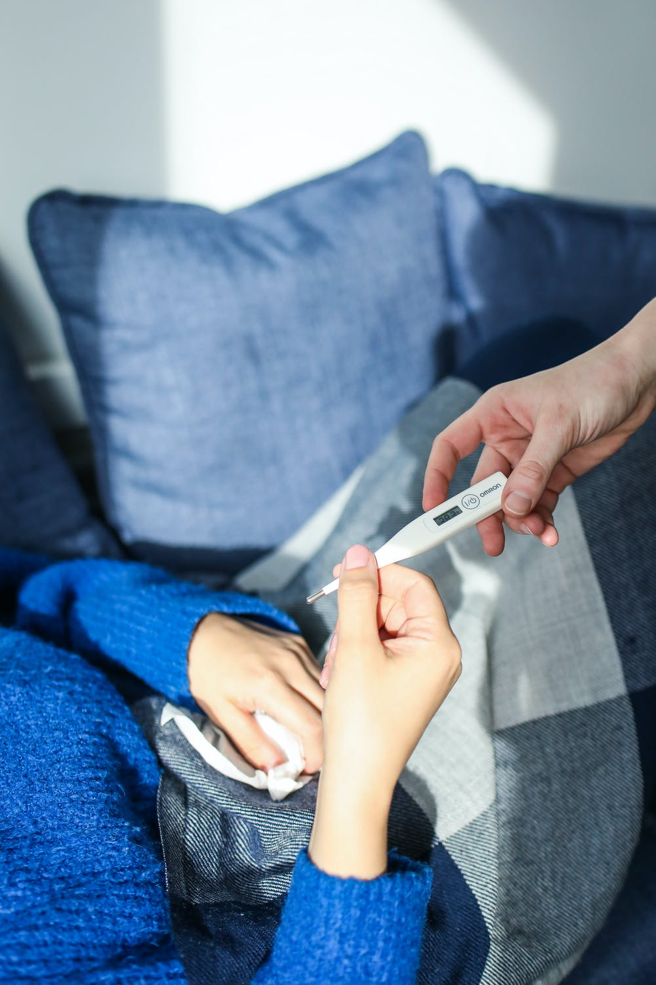
Don’t come to work if you are sick
Be extra careful if you don’t feel well. Do you have a fever? Sore throat? Diarrhea? You could be sick and don’t want to spread your sickness to others.
Call your supervisor if you feel sick. Stay home. Stay away from others. Call the doctor.
©2020 Betsy Lehman Center for Patient Safety

Slide 4
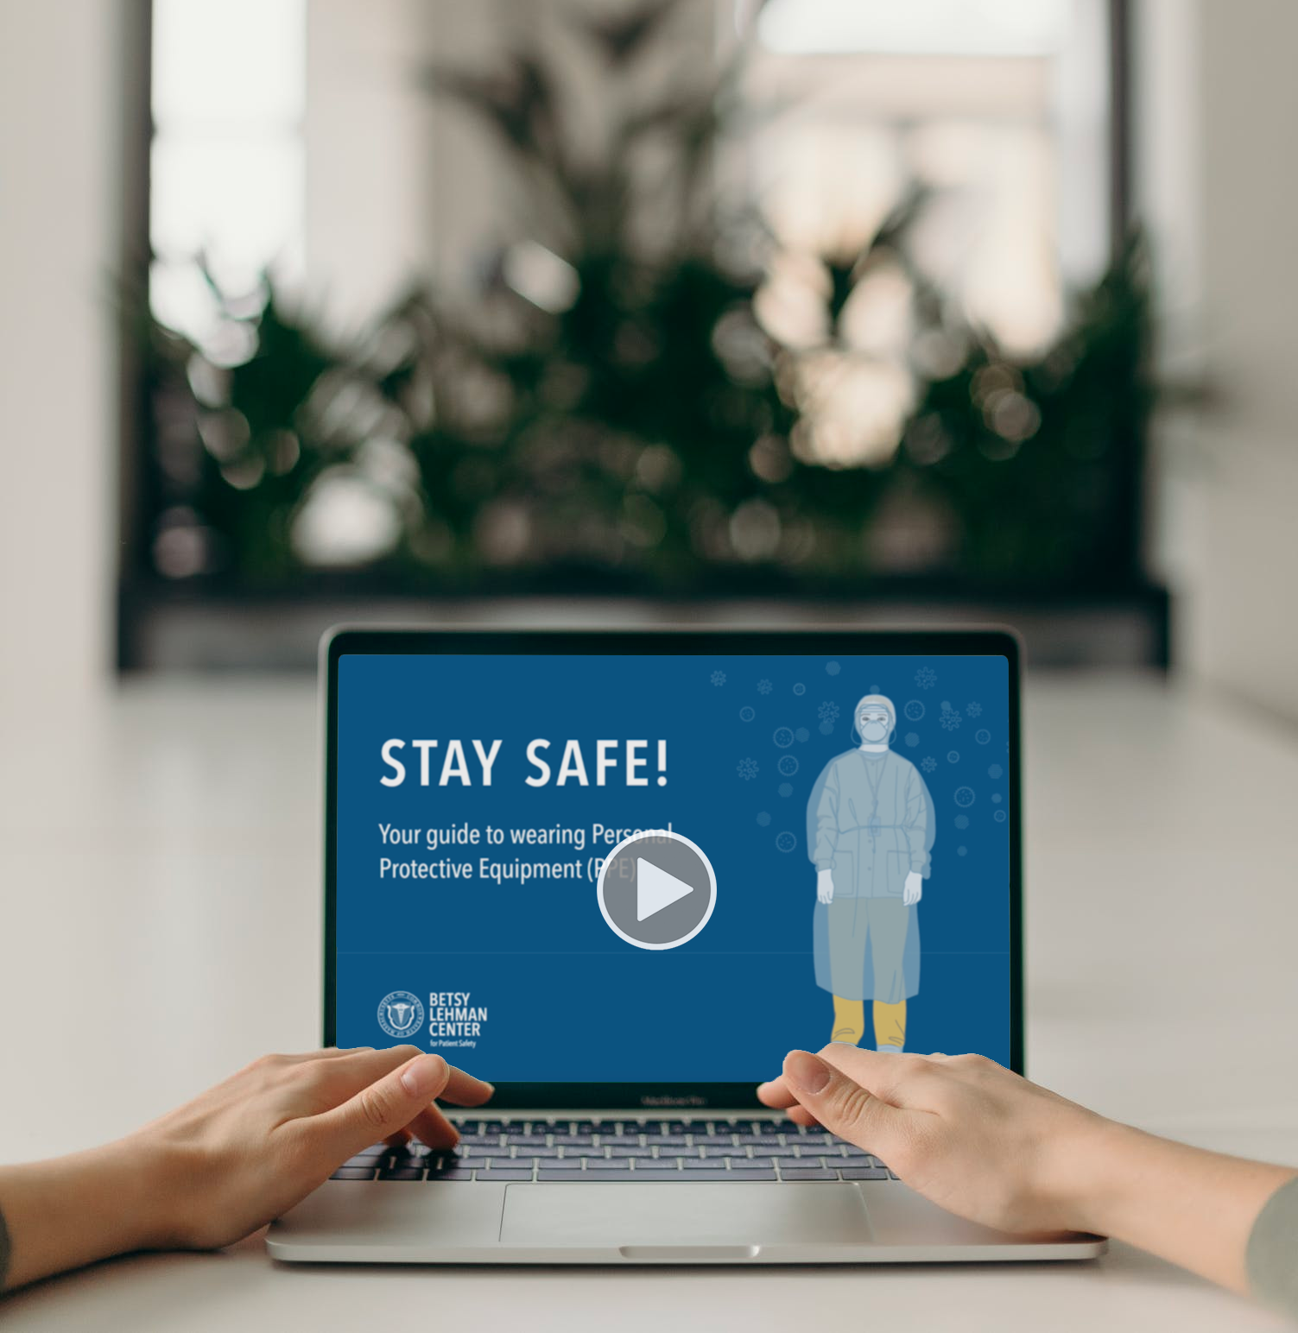

Know how to safely use PPE
Watch an easy-to-understand video with a best practice for putting on and taking off PPE:
BetsyLehmanCenterMA.gov/HomeCare
You may need to wear personal protective equipment (PPE) at work. Make sure you know how to use it safely.
©2020 Betsy Lehman Center for Patient Safety

