Slide 1
Peer Support (Best Hospital)

Slide 2
We are Creating a
Peer Support Service
for
Clinicians and Staff

Slide 3
What is Peer Support?
It is one person connecting with someone who has an understanding of what they are going through usually because they have been there. Peer support is emotional first aid for clinicians impacted by adverse events, medical errors or other traumatic events encountered in the course of caring for patients.

Slide 4
Why peer support?
Medical errors and other unexpected patient outcomes can traumatize not only patients and their and their loved ones, but members of the care team too.
Clinicians and staff may suffer emotional or physical distress, believing they have failed their patients and second-guessing their own clinical competence.
Some even decide to leave their positions or professions

Slide 5
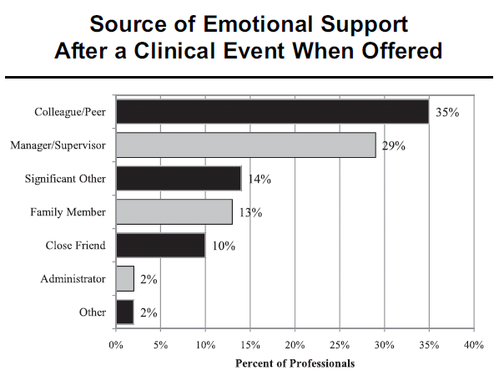
Preferred source of emotional support after a clinical event
Scott, S. Jt Comm J Qual and Pt Safety. Caring for Our Own: Deploying a Systemwide Second Victim Rapid Response Team. May 2010

Slide 6
Hallmarks of a Peer Support Program
Credibility of peers
Immediate availability
Voluntary access
Confidential
Emotional “first aid” (not therapy!)
Facilitated access to next level of support

Slide 7
What a peer supporter DOES
Provides one-on-one support to:
Normalize feelings of peer
Validation of your peer
Assess peer’s need for professional resources
Direct peer to other resources as appropriate
“Check in” with peer in the short term and long term

Slide 8
What a peer supporter does NOT do
Participate in Quality Assurance, RCAs
Offer disclosure coaching
Address job performance issues
Provide substance use disorder or violence prevention coaching
Advise on malpractice risk

Slide 9
How peer supporters reach out
In person (when the peer is alone or on an appropriate break from work)
On the phone
By email (when not urgent)

Slide 10
Challenges to providing support
Stigma to reaching out for help
High acuity areas have little time to integrate what has happened
Intense fear of the unknown
Fear a compromise of collegial relationships
Fear of legal implications (e.g., HIPAA, malpractice)

Slide 11
How it will work here:
Training date:
Which dept. is the pilot starting:
Team or point person for the program:
Process for activating peer support

