Slide 1
Sepsis
FHA Hospital Improvement Innovation Network (HIIN)

Slide 2
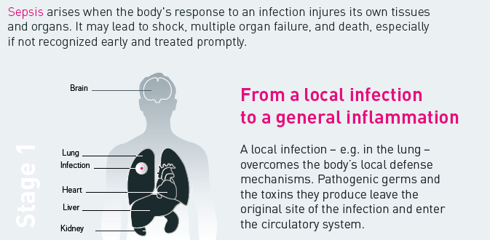
What is Sepsis?
Stage 1
Source: world-sepsis-day.org

Slide 3
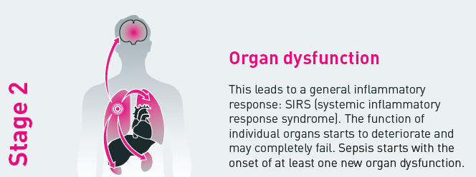
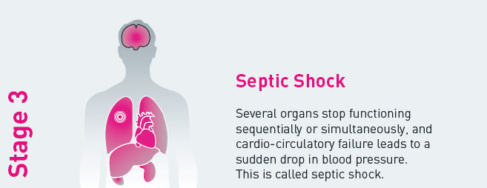
What is Sepsis?
Source: world-sepsis-day.org

Slide 4
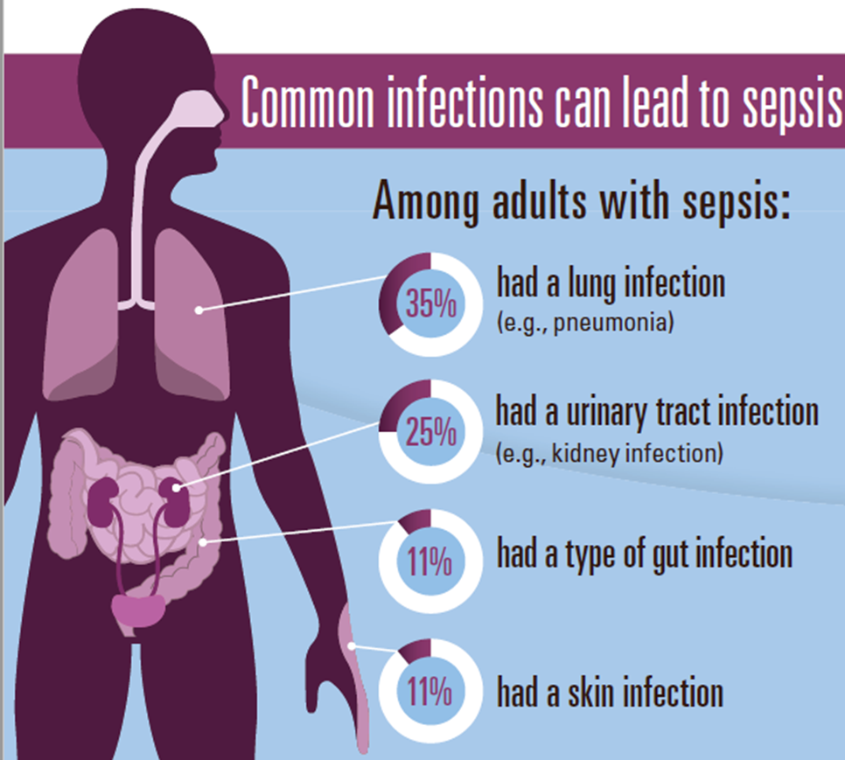

What is Sepsis?

Slide 5
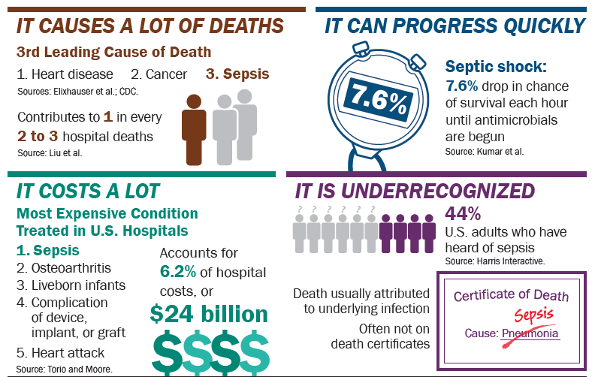
Sepsis at a Glance

Slide 6

Sepsis is a medical emergency . . .
minutes matter
Every hour a patient in septic shock doesn't receive antibiotics,
the risk of death increases by 7.6%.
Source: Advisory Board Company: “Why sepsis screening isn't one-size-fits-all” Expert Insight | December 11, 2013

Slide 7

Speed is Important
Time is Tissue!
Would you wait an hour to treat a stroke? Heart attack?
Mortality rates increase as the number of failing organs increase.

Slide 8
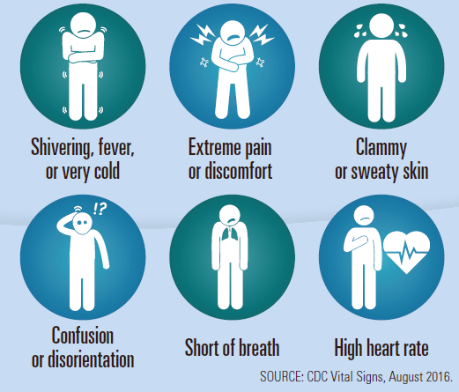
Know the Signs & Symptoms

Slide 9
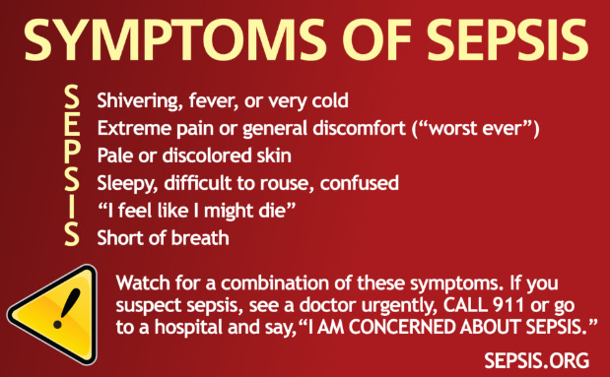
Know the Signs & Symptoms

Slide 10

3-Hour Bundle
To be completed within 3 hours of time of presentation*:
Measure lactate level
Obtain 2 sets of blood cultures prior to administration of antibiotics from 2 different sites.
Administer broad spectrum antibiotics
Administer 30ml/kg crystalloid IVF for hypotension or lactate ≥ 4 mmol/L
* “Time of presentation” is defined as the time of earliest chart annotation consistent with all the elements of severe sepsis or septic shock ascertained through chart review.
http://www.survivingsepsis.org/SiteCollectionDocuments/SSC_Bundle.pdf

Slide 11
6-Hour Bundle
To be completed within 6 hours of time of presentation
Apply vasopressors (for hypotension that does not respond to initial fluid resuscitation) and titrate pressors to a mean arterial pressure (MAP) ≥ 65 mm Hg.
In the event of persistent hypotension after initial fluid bolus (MAP < 65 mm Hg) or if initial lactate was ≥ 4 mmol/L, re-assess volume status and tissue perfusion and document findings.
If initial lactate is elevated > 2, re-measure lactate within 6 hours.
http://www.survivingsepsis.org/SiteCollectionDocuments/SSC_Bundle.pdf

Slide 12

Keys to Survival
Early Identification
  Subtle signs and symptoms
  Don’t wait until your patient is hypotensive!
  Appropriate antibiotics in a timely manner
  For every hour antibiotics are delayed during septic shock, the patient’s risk of death increases by 7.6%
  The single most important intervention in treating sepsis
  Source Control
  Antibiotics
  Surgery
  IV Fluids and vasopressors if necessary (hemodynamic stability)
  Emergency supportive care for acute organ dysfunction
  Ventilator
  Continuous Renal Replacement Therapy (CRRT)
  Prone positioning

Slide 13
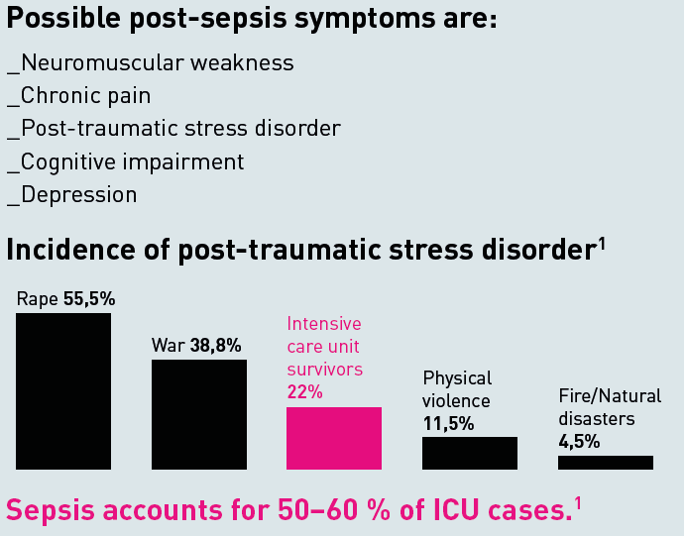

Life After Sepsis
Other symptoms can include:
Sleep disturbance, including insomnia
Extreme tiredness and fatigue
Inability to concentrate
Loss of confidence and self-belief
1_ Kessler RC, Sonnega A, Bromet E, et al.: Posttraumatic stress disorder in the National Comorbidity Survey. Arch Gen Psychiatry, 52: 1048–60, 1995. // Davydow DS, Gifford JM, Desai SV, et al.: Posttraumatic stress disorder in general intensive care unit survivors: a systematic review. Gen Hosp Psychiatry, 30: 421-434, 2008.

Slide 14

Healthcare Providers Can . . .
Prevent infections.
  Hand washing = #1 way to prevent infection
  Sterile Technique and Maintenance
    Foley insertion (and maintenance)
    Line insertion and draws (and maintenance)
    Invasive procedures
  Vaccines
    Flu and pneumonia shots
Reassess patient management. Check patient progress frequently. Reassess antibiotic therapy 24-48 hours or sooner to change therapy as needed (narrow the spectrum). Be sure the antibiotic type, dose, and duration are correct.
Educate patients and their families. Stress the need to prevent infections, manage chronic conditions, and seek care if signs of severe infection or sepsis are present.

