Slide 1
Virtual Peer Support Network
Partnering with the Betsy Lehman Center for Patient Safety to offer free, confidential support to clinicians and staff in our organization

Slide 2
Background

Slide 3
What is peer support?
Peer support occurs when people who have the same lived experience provide knowledge, experience, emotional, social or practical help to each other.
It commonly refers to an initiative consisting of trained supporters, and can take several forms such as peer mentoring, validation, reflective listening, normalizing feelings and in some cases refer to additional services.
Notes:
Linda

Slide 4
Hallmarks of a peer support program
Credibility of peers
Immediate availability
Voluntary access
Confidential
Emotional “first aid” (not therapy)
Facilitated access to next level of support
Notes:
Linda

Slide 5
What is peer support...
DOES:
Normalizes feelings of peer
Validates competence of peer
Assesses peer’s need for professional resources
Directs peer to other resources as appropriate
Follows up with peer in the short term and long term to “check-in”
DOES NOT:
Participate in Quality Assurance, RCAs
Offer disclosure coaching
Deal with job performance issues
Handle substance abuse coaching or violence prevention
Offer malpractice suit support (there are other resources for this)

Slide 6
About the Virtual Peer
Support Network

Slide 7
Benefits
No cost
Free for all health care professionals in Massachusetts
Virtual
External peer support program without the administrative challenges
Confidential
Anonymity for people who want to talk with someone outside their organization
For all staff
Talk 1:1 with someone in a similar role, whether that be direct care, administration, facilities, environmental services, or something else

Slide 8
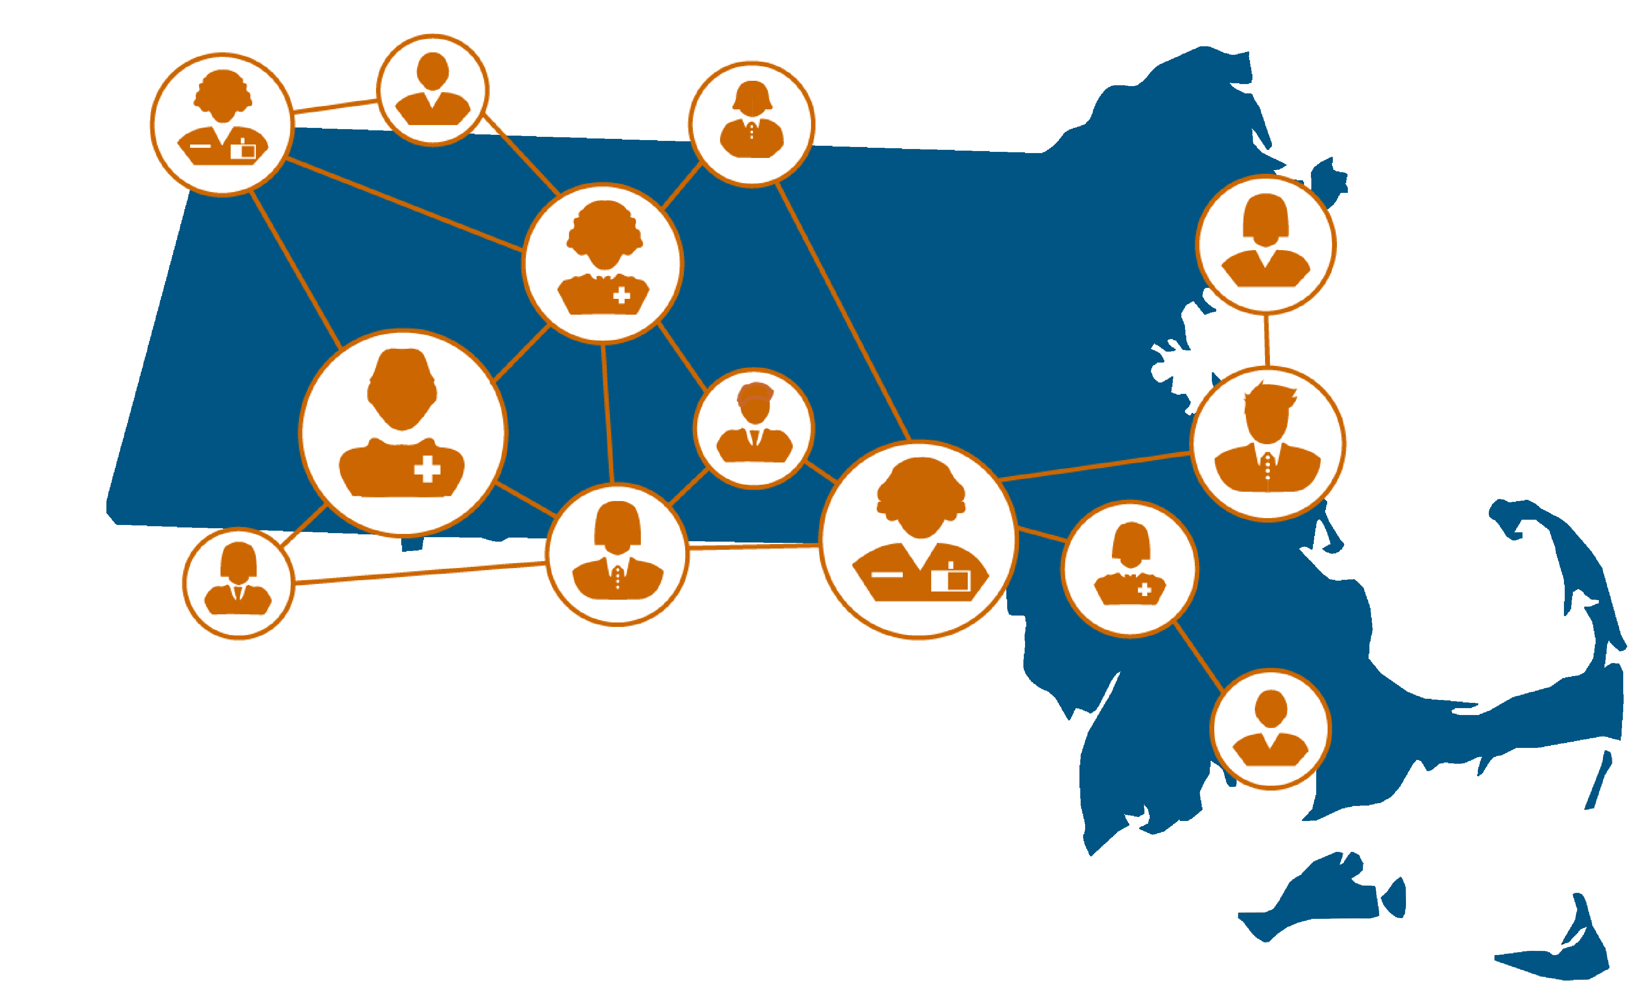
How it works
Individuals who need support are matched to a trained peer supporter
Same peer support model that we use with organizations
How to reach us:
  Request form
  BetsyLehmanCenterMA.gov/VirtualPeerSupport
Notes:
Revise these icons

Slide 9
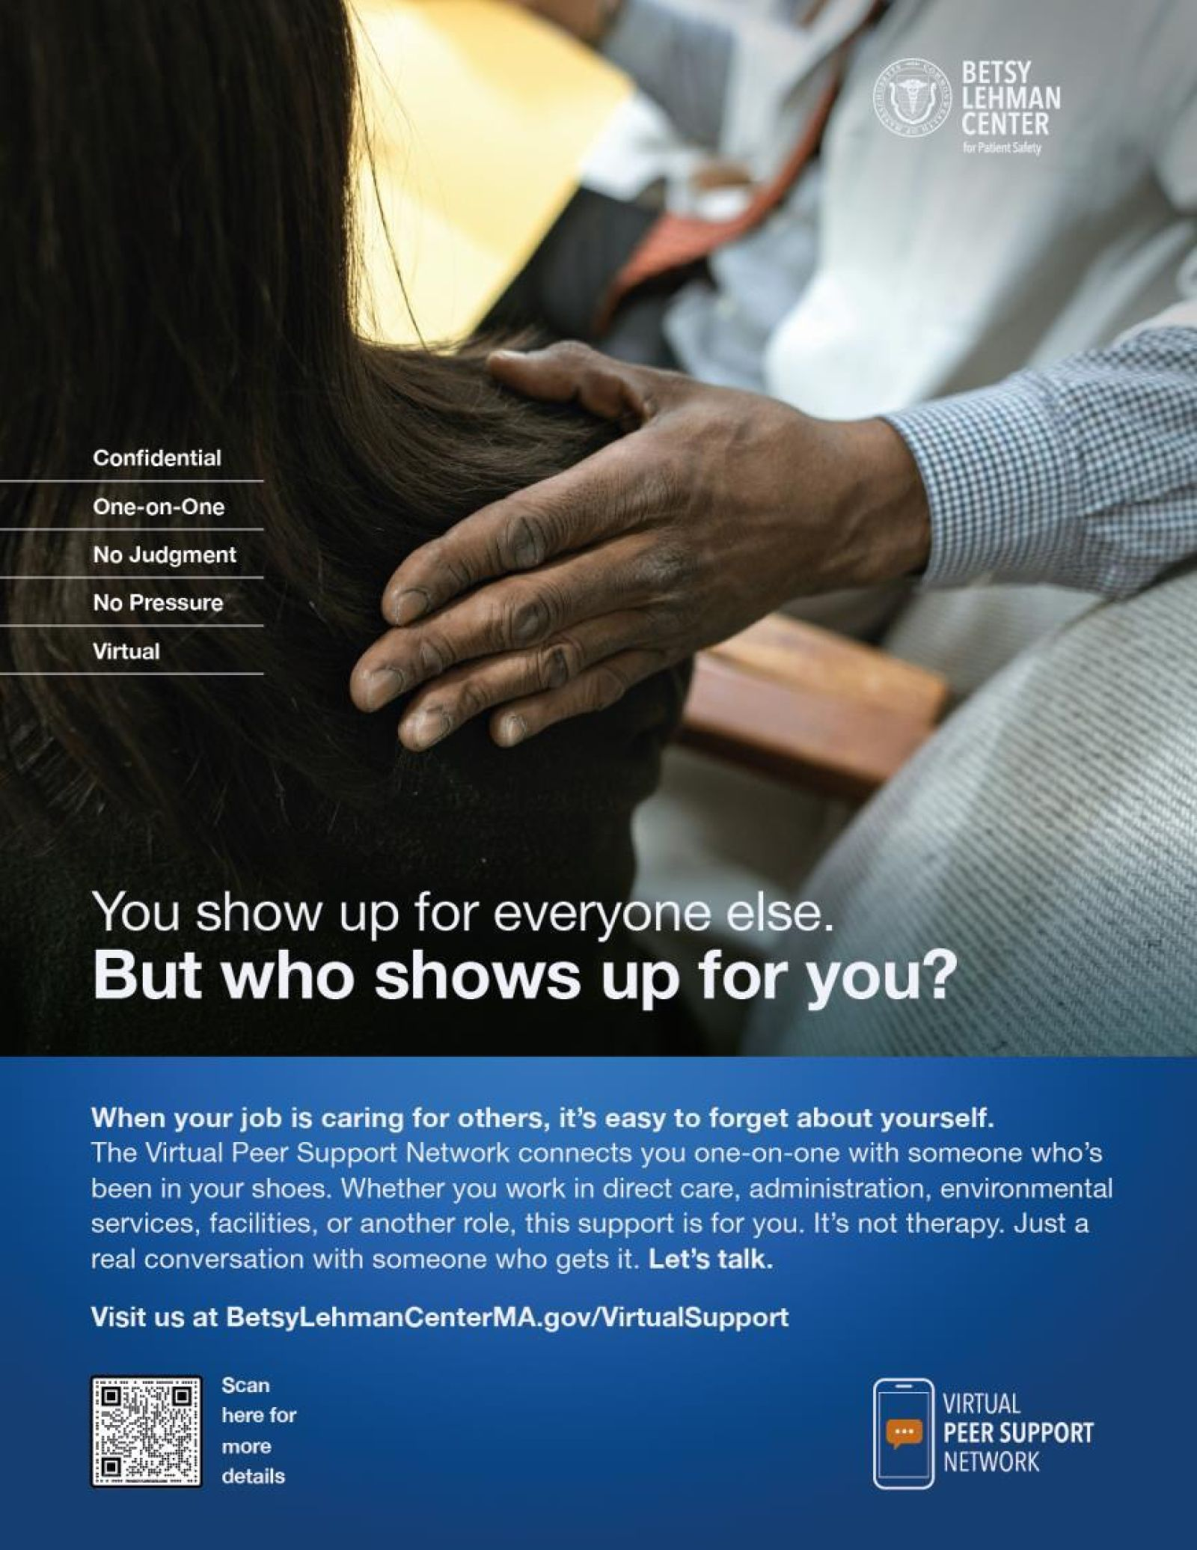

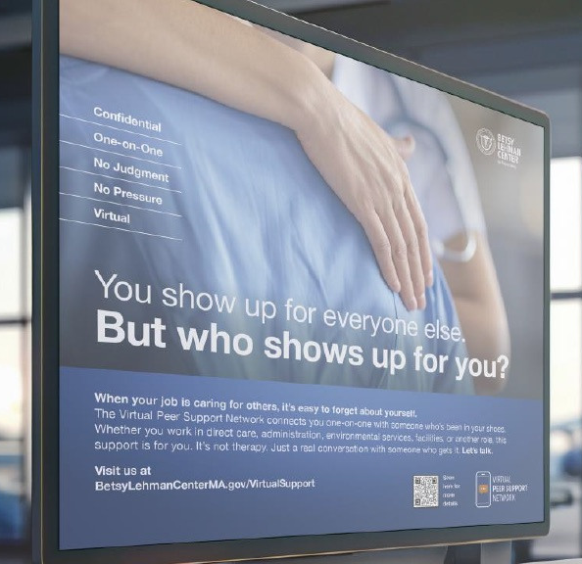
Promote the network
Advertise only
    Download materials on our website
Co-brand
    Internal marketing and communication plan
    Trained peer supporters
    Monthly meetings
    Resources on our website

Slide 10
Protection language for the Betsy Lehman Center
Under Massachusetts law (M.G.L. c. 12C, section 15), information collected by or reported to the Betsy Lehman Center is confidential. It is not public record and is not subject to subpoena or discovery or introduction into evidence in any judicial or administrative proceeding (except as otherwise specifically provided by law).
While we believe this statute clearly allows the Center to maintain confidentiality of the information we receive through our Peer Support Programs, it has never been challenged or interpreted in a legal proceeding and we cannot predict the future actions of litigants or courts. If the Center were to receive a request or demand for information for which we had promised confidentiality under our reasonable read of the statute, we would not release the information without the consent of the individual(s) from whom we received the information unless ordered to do so by a court of final jurisdiction.

Slide 11
Thank you!
The Betsy Lehman Center’s peer support team is here to help.
Contact information:
  Peer.Support@BetsyLehmanCenterMA.gov

